Slide 1
Walmart Customer Retention Analytics
~ By Rishav Vishnoi

Slide 2
Project Introduction:
Walmart faces increasing competition from Amazon and Target in the retail space, making customer retention critical for sustained growth.
Operates across hypermarkets, discount stores, and e-commerce platforms worldwide.
Collects vast customer data but lacks analytical depth for retention strategies.
Requires actionable insights to understand churn drivers and loyalty patterns.

Slide 3
Problem Statement:
Walmart's current reporting system cannot effectively answer critical retention questions:
Why are customers churning across different segments?
How to identify loyal versus at-risk customers?
What is the impact of loyalty programs and promotions on retention?
Which regions and channels need targeted retention strategies?

Slide 4
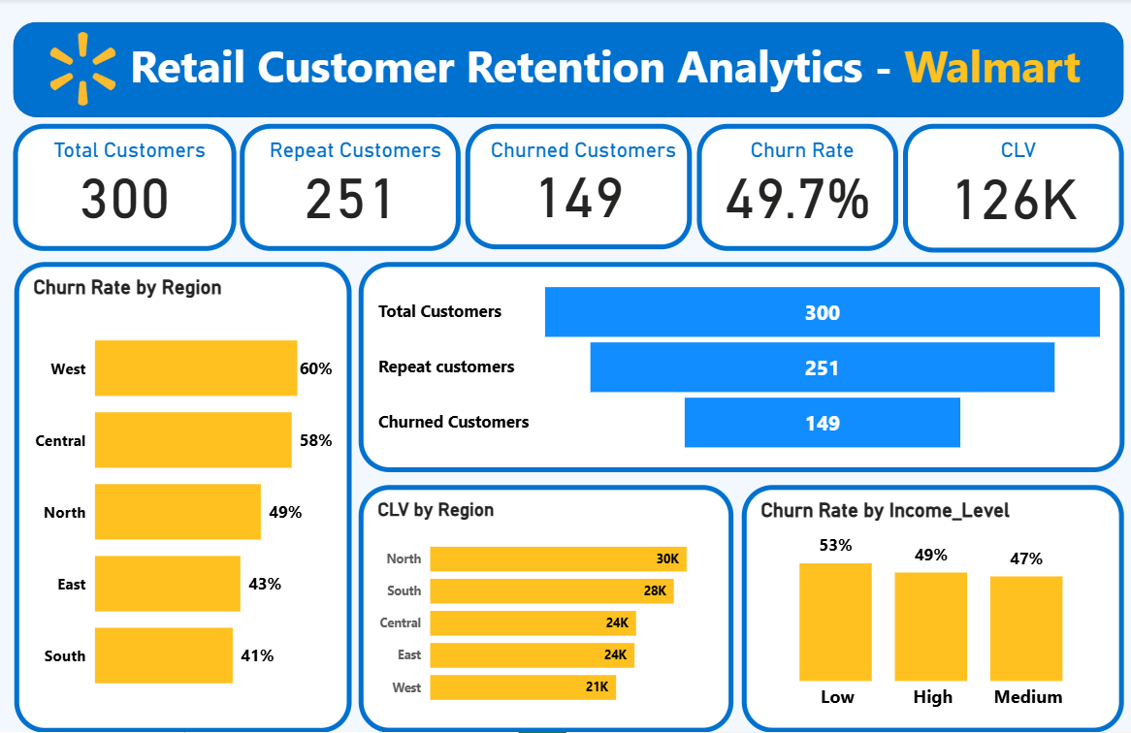
KPIs:

Slide 5
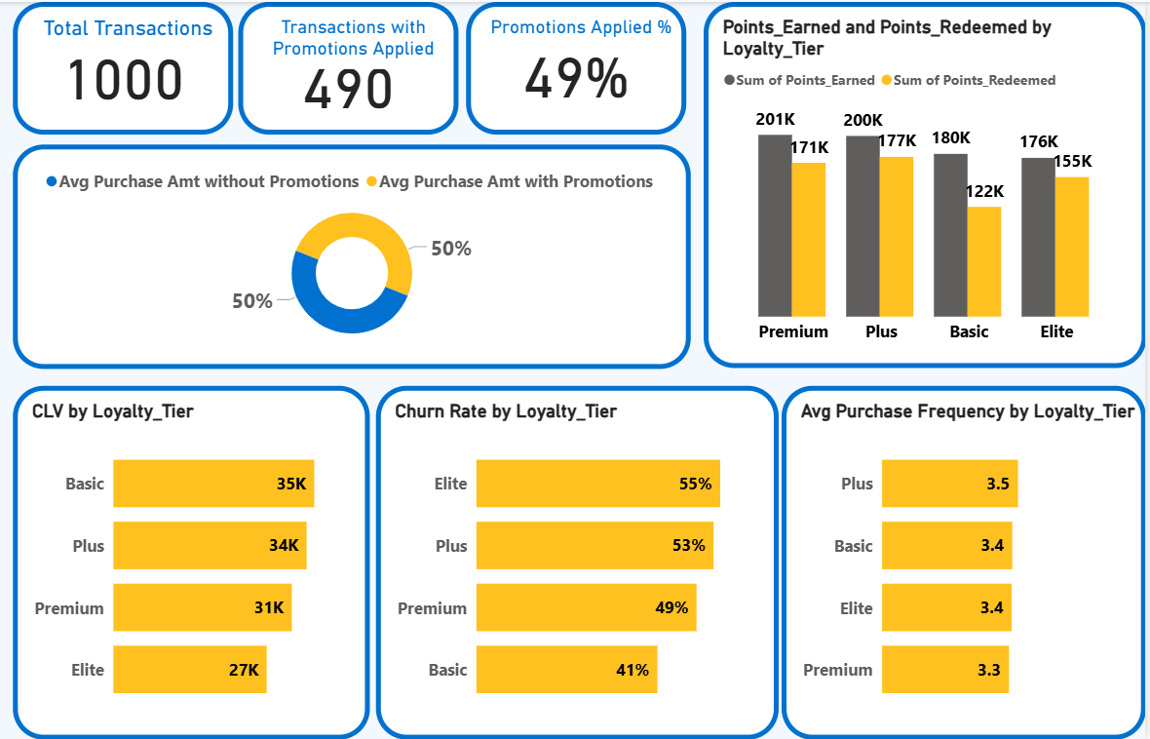
Loyalty Impact:

Slide 6
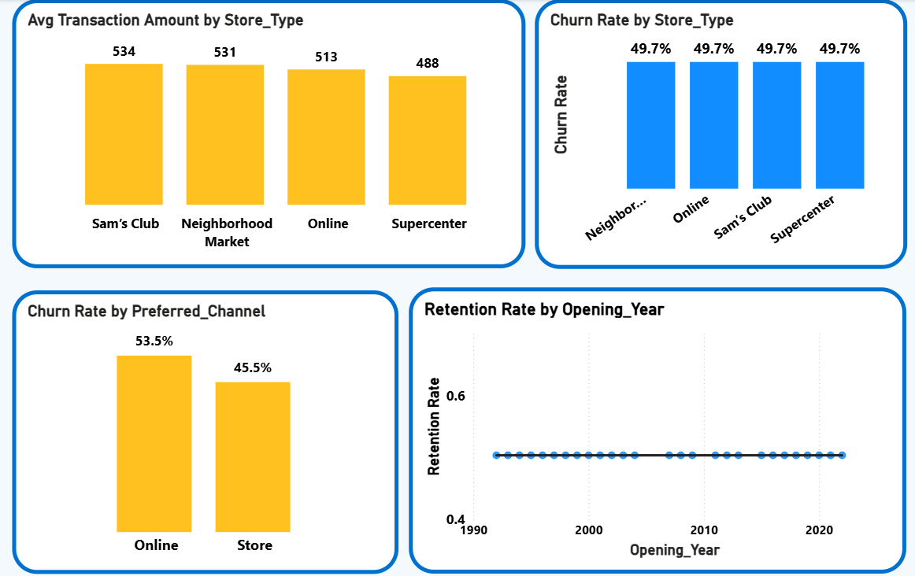
Store /
Channel
Insights:

Slide 7
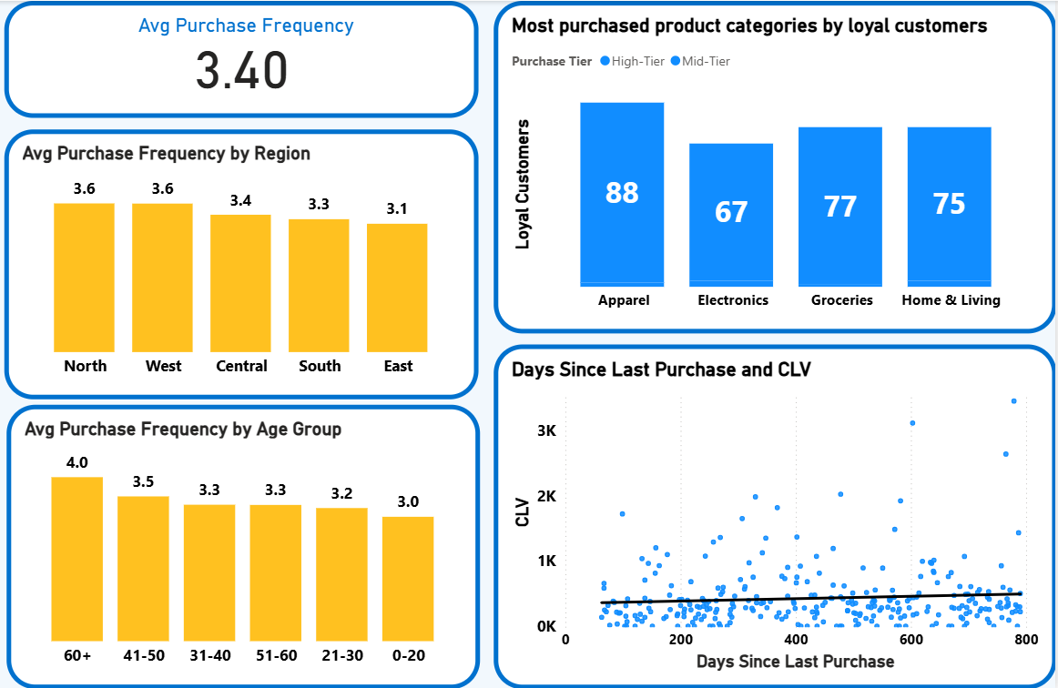
Segmentation:

Slide 8
Key Finding 1: Critical Churn Patterns
49.7% overall churn rate indicates significant retention challenges across all segments.
Elite tier has highest churn (55%) despite premium benefits - program value not meeting expectations.
Online channel shows 53.5% churn vs 45.5% for stores - digital experience needs improvement.
West region leads churn at 60% followed by Central (58%) - regional strategy gaps evident.

Slide 9
Key Finding 2: Loyalty Program Inefficiencies
Low redemption rates across all tiers - customers earn points but don't redeem (Premium: 171K earned vs 24K redeemed).
Basic tier shows highest CLV (35K) despite being lowest tier - value proposition misalignment.
Promotions show neutral impact - 50/50 split suggests they're not driving incremental retention.

Slide 10
Conclusion & Next Steps
The dashboard reveals significant opportunities to improve customer retention through targeted interventions:
Address Elite tier churn with enhanced value proposition.
Boost loyalty program engagement through simplified redemption.
Implement region-specific retention strategies for West and Central.
Improve online channel experience to match in-store retention rates.

Slide 11
Thank You

